Slide 1
Stress in the Work Place
Brandon Williams
Christopher Nawrocki
Kristine Gipe
Matt Harrington
Notes:
I am going to keep this short. You are all busy and long presentations can be stressful.
Lets start by looking at some user stories

Slide 2
Stories
I am not good at my job
I cannot keep up with this workload
Notes:
I can never figure it out fast enough
I am always falling behind

Slide 3
Stories
I am tasked with managing something I cannot control
I am accountable to too many customers
Notes:
I cannot fix the thing that I am responsible for
Too many people depend on me for answers

Slide 4
Stories
I am taking too much FTO
When I take FTO, work piles up
Notes:
What is the right amount of FTO?
If I take a break, my job will get harder. Work will stack up, or someone else will screw up.
This all leads into…

Slide 5
Stories
I could lose my job
Notes:
And what’s more…

Slide 6
Stories
Why doesn’t anyone else feel like this?
Notes:
This is called imposter syndrome.
The inability to internalize our own accomplishments
The fear of being exposed as frauds.

Slide 7
Stress
Stress is a problem of productivity
Stress leads to burnout
Notes:
Stress impacts memory and focus
Interferes with teamwork
It can cause all sorts of other medical problems
Burnt employees are unhappy, less productive, and likely to leave the company.

Slide 8
So?
Isn’t stress a personal problem?
Notes:
Stress is a human problem, so why should comScore do something about it?

Slide 9
comScore Should Care
People are investments
Notes:
Because, people are investments.
It takes time to train someone
When someone leaves, they take all of their knowledge and experience with them
It is the people take make comScore succeed

Slide 10
You Should Care
You don’t work alone
Notes:
We can’t deal with stress alone. It is difficult to measure and, stress itself, makes it harder to “see” and understand stress.
Anxiety is contagious
Helping those around us makes our lives better and makes us better humans

Slide 11
What Next?
Talk
Notes:
It would be silly of me to say I could fix this, during the Hackathon, or at all.
Engineers are special people; there’s something wrong with all of us. That’s what makes us good at our jobs.
What I can do is raise awareness, start a dialog.
We’re not alone. In fact, we have a lot of support.

Slide 12
What Next?
Brandon Williams
Carlos Fuentes
Christopher Nawrocki
Colin Hyzy
Doug Bell
Eric Daniel
Eric Mowrer
James Loope
James Whiteneck
Jason Weiss
Joe Ruthruff
Jeff Ozvold
Jeon Rezvani
Kevin Kerber
Kristine Gipe
Mary Lee
Michael Vinson
Naoko Shimada
Sam Slocom
Scott Wainstock
Notes:
2 months ago, I spent a day having one on one conversations with everyone on this list.
These are team leads, managers, and directors in every team on this floor.
Each expressed interest in exerting effort towards improving mental health in the work place.
Lets prioritize this.
Stress is not going to go away, but we can do things, sometimes little things, to make our community stronger, healthier, and more efficient.
For example, some people like light offices, some like dark. We could optimize based on that.
By spending time on this, we are improving comScore’s investment in us.
BTW, in the last 2 months, 10% of these people have already left the company.

Slide 13
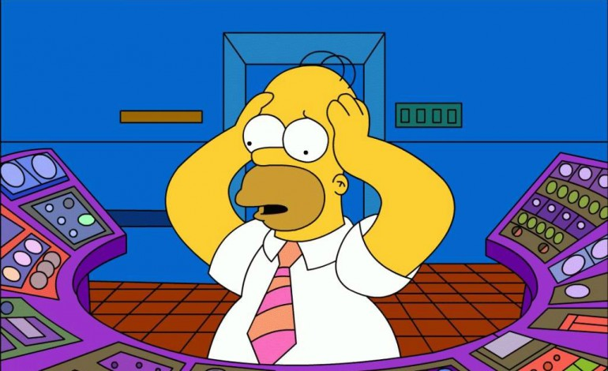
Thank You
Notes:
Thank you

